Slide 1
Nodes Tools
Mack 2023

Slide 2
Learning Objectives
Students will be able to identify and use the different tools for moving, rotating, and scaling nodes in Godot.
Students will understand the concept of parenting nodes and be able to create and add child nodes to a parent node.
Students will recognize how properties are inherited by child nodes from their parent nodes.

Slide 3
Node Tools
In this lesson, we will be looking at the different tools we can use to move, rotate and scale our nodes in Godot, directly from the viewport window. In the top left of the window, there are 4 tools that can be selected for use in the viewport, we will cover them now.

Slide 4
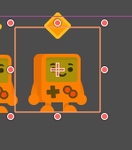

Select Mode
When we use the Select Mode, we can select a node by clicking on it. This will highlight the node for use with the other tools.
You can also choose the Select Mode using the keyboard shortcut Q.

Slide 5
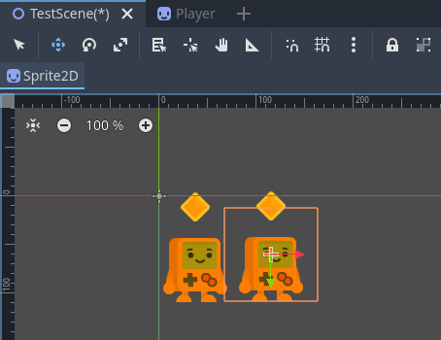
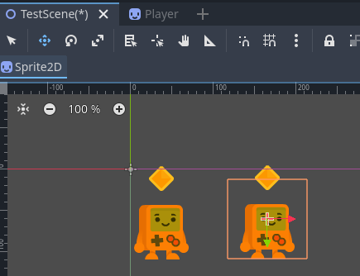
Move Mode
When we enable the Move Mode, we can move the node around by clicking and dragging on it or by using the red and green arrows to move the node along the x and y axes respectively. This will directly change the Position property in the Inspector window.
Alternatively, to choose the Move Mode, we can use the keyboard shortcut W.

Slide 6
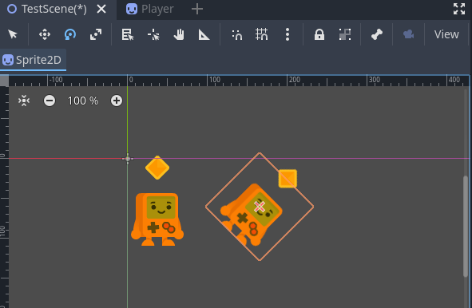
Rotate Mode
Next to the Move Mode is the Rotate Mode. You can use this to rotate objects around their pivot by dragging away from the sprite.
You can also choose the Rotate Mode by using the keyboard shortcut, E

Slide 7
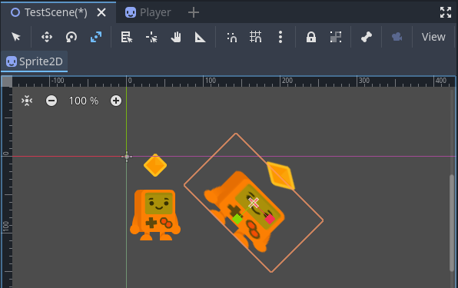
Scale Mode
The final mode is the Scale Mode, which we can use to scale the node by clicking and dragging on it. You can also click and drag on the red and green boxes to scale the node along the specific axes.

Slide 8

Challenge
As a challenge, try to create a new Sprite node with the coin texture, and then duplicate, position, rotate and scale the nodes to match the image below.

Slide 9
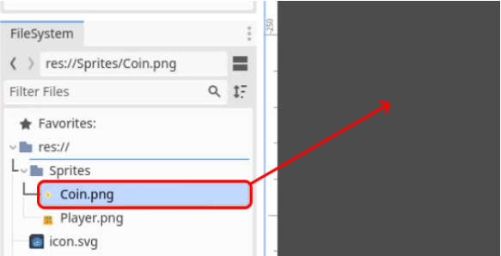
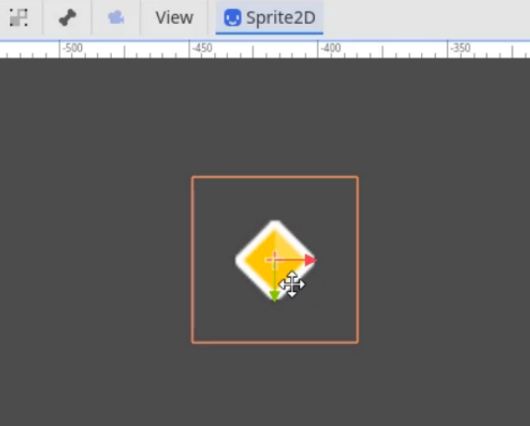
Challenge Solution
Firstly, we need to create our Sprite2D node to drag and drop the Coin.png file into the scene. This will automatically create a Sprite2D node and assign the texture to it and is easier than creating it through the create node menu.
With the Move Tool selected, you can then move the coin into the first position.

Slide 10
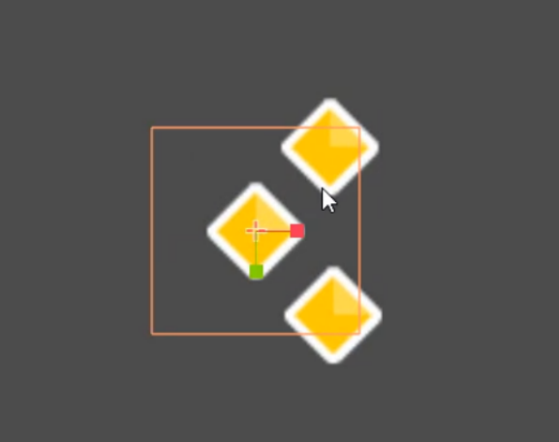
Challenge Solution
We can now Duplicate that sprite twice (using the CTRL+D) shortcut and move them into position.

Slide 11
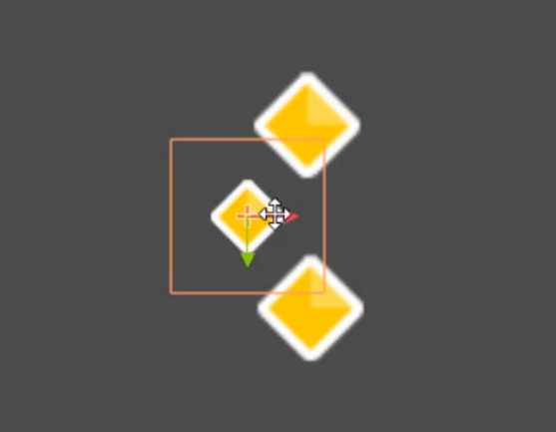
Challenge Solution
We will now Scale the middle coin, holding Shift to make it scale uniformly.

Slide 12
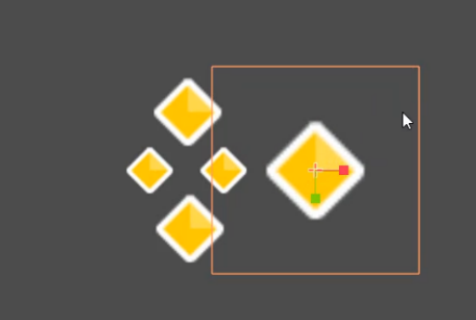
Challenge Solution
We can then Duplicate this smaller coin and move it into position on the right.

Slide 13
Challenge Solution
We can then Duplicate, Move and Scale another node to the right of this.

Slide 14
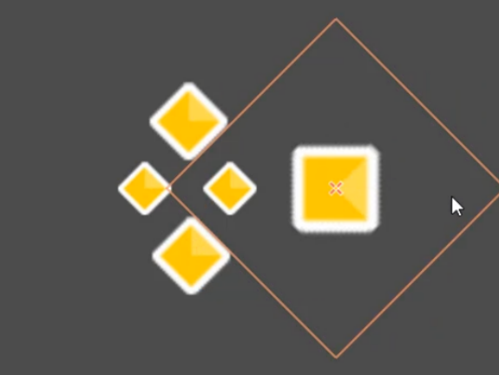
Challenge Solution
Then Rotate this into position, like with the scale tool, hold down Control to make the rotation snap, allowing you to align the coin easier.

Slide 15
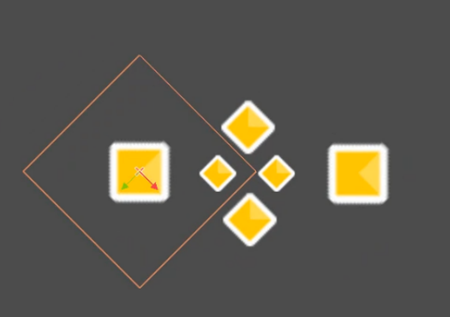
Challenge Solution
Finally, Duplicate and Move this square sprite to the left as well to complete the pattern.

Slide 16
Challenge Solution
Having a good understanding of these tools is extremely important to making games in Godot, as it can help with anything from aligning colliders to sprites to dragging scenes into a level. Be sure to keep practicing using them until you’re sure you understand them fully.

Slide 17
Parenting
Parenting is an important concept to understand when working with the Godot Engine. It is used to create relationships between nodes, allowing them to inherit properties such as position, rotation and scale.
Any node that isn’t the root node will be a child of at least one parent, so it is important to understand the effects of this.

Slide 18
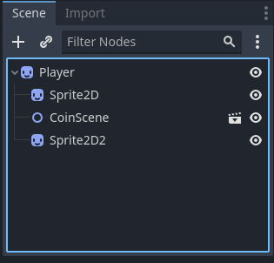
Parenting
To start, we need to create a new node. To do this, click on the plus icon in the Scene tab. For this test, we will use a Sprite2D node, which we can find by searching for sprite.
We can then press the Create button to add it to our scene.

Slide 19
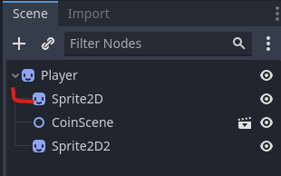
Parenting
If you look in the Scene tab, you will notice the new node (Sprite2D) will be a child of the root node (Node2D), unless you specify otherwise. This is evidenced by the fact it is indented by one stage to the right below the root node. Every child node will be indented below its parent, so you can see it is a child node. This is a similar concept to the way folders can have subfolders which can have more subfolders.

Slide 20

Parenting
You can also use the dropdown arrow next to a parent node to hide its child nodes in the Scene, this can help for the organization of larger projects.
We can also set the Texture property of the new sprite node to the Player.png value.

Slide 21
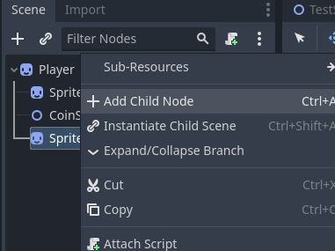
Parenting
Once you have created a node, you can create a child node for it. To do this, right-click on the node and select the Add Child Node button.

Slide 22
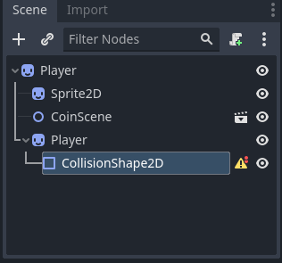
Parenting
This will bring up the Create New Node window again. For this character, if we want to give our Sprite 2D node a collider, we can search for the Collision Shape 2D node and create it.
This node will now be a child of the Sprite2D node, which will be shown by an indent in the Scene tab.

Slide 23
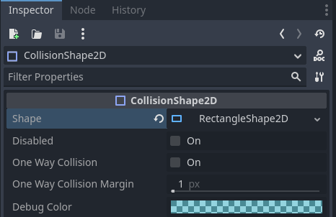
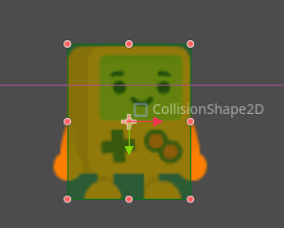
Parenting
We can add a Shape property to the CollisionShape2D node, we will be using the RectangleShape2D option.
This can then be scaled to the size of the player sprite using the orange circles on the edge of the rectangle in the viewport.

Slide 24
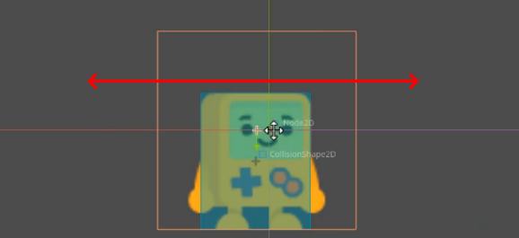
Inheriting Properties
Once a node is a child of another node, it will inherit the properties of its parent. This means that if the parent node is moved, rotated, or scaled, the child node will also move, rotate or scale accordingly. This can be tested by selecting the Sprite2D parent node in the Scene tab.

Slide 25
Inheriting Properties
If you then move the node with the Move mode by pressing W, you will notice the CollisionShape2D node moves with its parent, as it is inheriting the property from its parent node. The same will be true for the rotate and scale tools.

Slide 26
Inheriting Properties
This is useful for creating relationships between nodes, such as having a camera follow a player. For example, if you wanted your player to hold an item, you can make the item a child of the player and it will move with the player.

